Slide 1
OOP
C.K.Leng

Slide 2
From Modular to Object-Oriented
Software Crisis
C++
Information Hiding
“Do the right things” Vs “Do the things right”
The Software Complexity grow until we can’t manage
Programming in the Large
Increase Likelihood of success
WHAT
HOW

Slide 3
Where the OO idea came from?
The OO is rooted from AI
Knowledge Representation Techniques
  Script
  Logic
  Semantic Net
  Frame
  Etc…

Slide 4
What is Object?
Object can be
  Physical (Tangible)
  Logical (Intangible)
From another perspective, Object can be
  Simple
  Complex
  Depends on Context
  Vary by Perception
Every object must has Unique Identity

Slide 5



Aspects of Object
Attributes
Name=Trump
Gender=Male
Age=74
Height=6’3”
Wight=243Pound
Attribute
Values
Stingy
Hot Temper
Behavior
Adjective
State
Examples:
Rich/Poor
Young/Old
Noun
President of United State
Father of Ivanka Trump
Relationship

Slide 6
Classification and Encapsulation
Concept
Language as Tool
Vocabulary of language provides symbolic representation of Concepts
Classification = Process of grouping objects by comparing their common aspects to form concepts about them.
Classification
  Attribute Set
  Attribute Value/State
  Relationship
  Behavior
Concept
Encapsulation
Class
Behavior
Name
Operation (WHAT)
Attributes
Method
(HOW)

Slide 7
Abstraction
Model represents the understanding of developer about the problem domain.
Do we need to capture every single aspects of objects in to the model?
Abstraction = The process of focusing on essential but ignoring non-essential aspects during modeling process.

Slide 8



Abstraction
Constraints that stop you from fully understand the objects:
Question: Do you really need to understand everything about the objects in order to solve problem?
Answer: No. We just need to understand sufficiently
Definition: The process of simplify the real world problem by focusing on essential aspects and ignoring the rest in order to achieve certain objective
Skill Set
Time
Budget
Abstraction

Slide 9

Modeling
Encapsulation
Model
Problem Domain
+
Abstraction

Slide 10
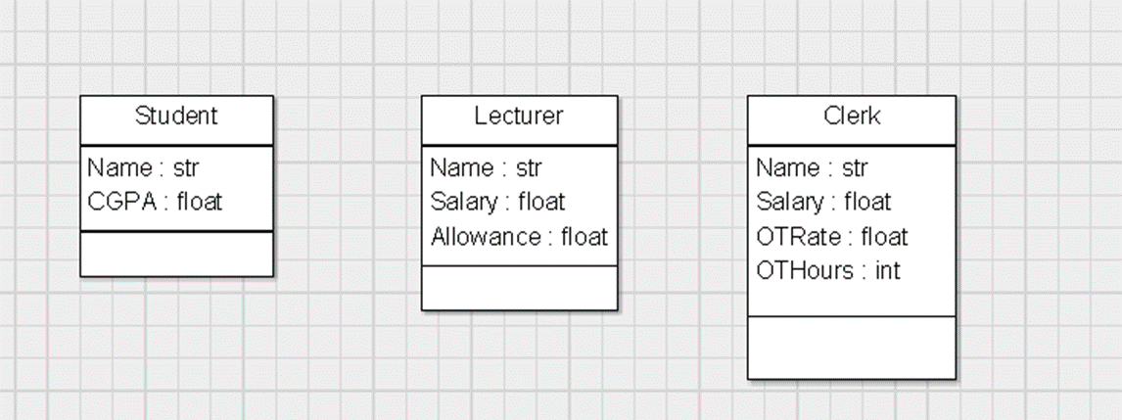
Example Modeling: University
Initial Model:
s1
s2

Slide 11
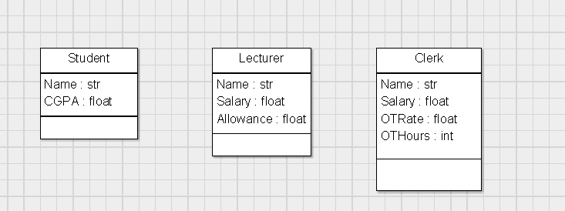
Modeling Refinement: Generalization
Focus on those common aspects in model and Refactor-Up:

Slide 12
Modeling Refinement: Specialization
How to justify new specific classes generated?
Three Types of specialization:
Restriction (-)
Extension (+)
Overriding (*)
Polymorphism

Slide 13
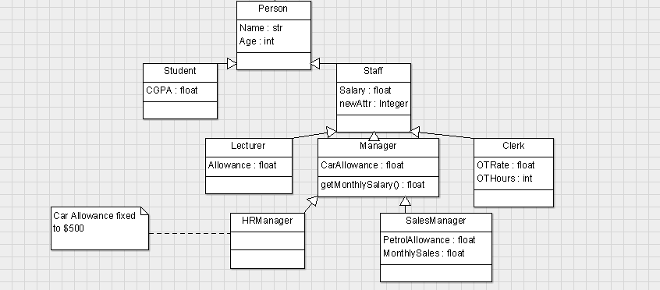
Model after refinement

Slide 14
Relationships
Following are different types of relationship
  IS-A (or Kind-Of)
  Part-Of (Aggregation)
  Part-Of (Composition)
  Association
  Dependency
  Realization
In this course, we only cover the first 4 types

Slide 15
Relationship: Cardinality/Multiplicity
1 to 1
1 to Many
Many to 1
Many to Many

Slide 16
Aggregation Vs Composition
Both are Part-Of relationship
Under Composition, component can’t exists alone without the composite.
Composition is stronger form of Part-Of
Example:
Car
4
Wheel
OR
Car
4
Wheel
Car Sales System
Car repair Workshop

Slide 17
How to identify relationship type?
Given class X relate to class Y with relation R. How to determine type of R?
Steps:
  Test for IS-A relationship
  Test for Part-Of relationship
  Define Association
Client
order
Product

Slide 18
Test for Is-A relationship
Answer both of the following questions:
  Is X a Y?
  Is Y a X?
Both questions will provide result either in True or False.
Is-A exists only when only one of the question is True.
Next, you have to determine which class is more general and which is more specific
Cardinality is NOT applicable to Is-A relationship

Slide 19
Test for Part-Of relationship
Answer both of the following questions:
  Is X part-of Y?
  Is Y part-of X?
Both questions will provide result either in True or False.
Part-Of exists only when one or both of the questions are True.
Next, you have to determine which class is composite and which is component.
The Cardinality should be either 1-to-1 or 1-to-Many. If you encountered the cardinality is Many-to-Many, It is NOT Part-Of, should be Association instead.

Slide 20
Define Association
Can be directional or bidirectional
Can use Association Name or Role
Have to decide Cardinality

Slide 21
Roles
Use Roles?
Student
Learner
Teacher
Lecturer
Mentee
Mentor

Slide 22
Your Challenge
Given the following, can you determine the type of relation for R?
Circle
Ellipse
(Oval)
R

Slide 23
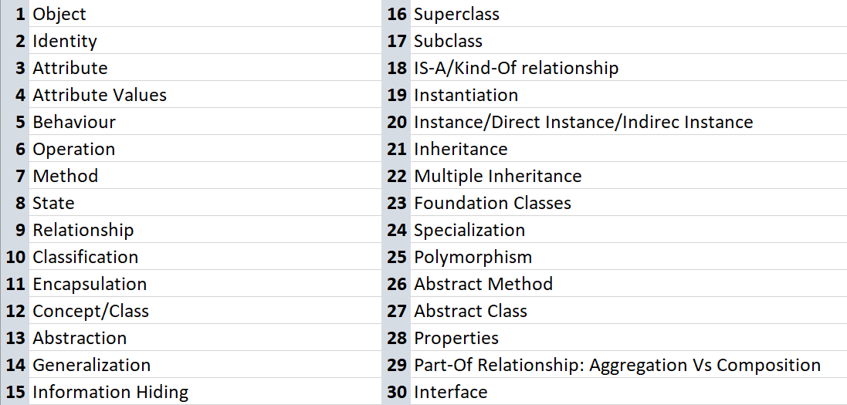
OO Terms

